Slide 1






Basic Details of the Team and Problem Statement
PS ID: T3PS03
Problem Statement Title: BLOCKCHAIN FOR RENEWABLE ENERGY TRADING
Team Name: ECO LEDGENCE
Team Leader Name: KARMUHILAN D B
Institute Name: RATHINAM COLLEGE OF ARTS AND SCIENCE

Slide 2
PROBLEM SIGNIFICANCE
Poor returns of the Investment
In comparison to solar investors, who earn
a sufficient profit ratio, consumers receive a lower profit ratio
Compatibility Issues
Incompatibility with existing system
or software
High Commission
Higher transactional Commission
Vendor Lock-in
Difficulty in switching vendors or migrating to different software solutions
Exacerbated Pollutants scale
The use of coal plant to produce 260 units of electricity results in 2.14kg of
carbon emissions
Complexity
Required extensive learning for users

Slide 3
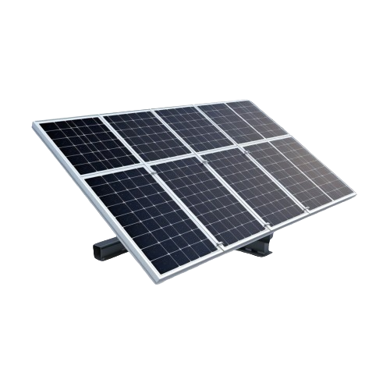
PROBLEM STATEMENT
Ineffective platform for the energy trading market economy; and insufficient details of real-time tracking, transparency, and rising carbon emissions

Slide 4
Existing energy trading Nations and Companies :-
UNITED STATES
Power ledger,LO3energy,Grid+
JAPAN
Power ledger
UNITED KINGDOM
Energimine
SLOVENIA
Sun Contract
SPAIN
Wepower
AUSTRALIA
Power ledger,Wepower

Slide 5



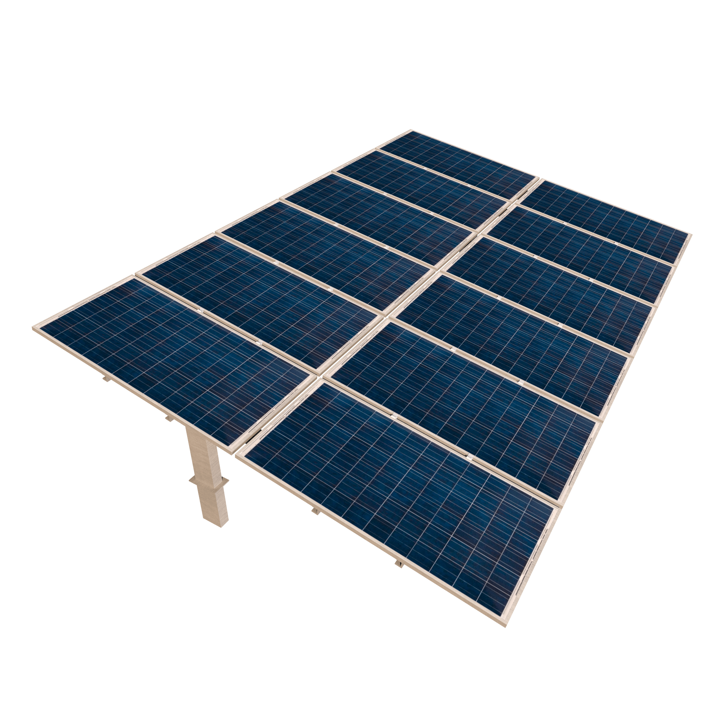

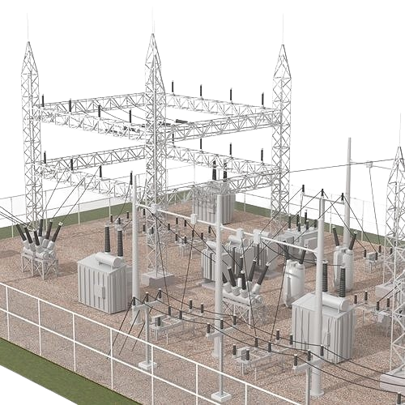
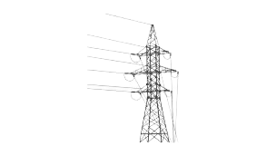
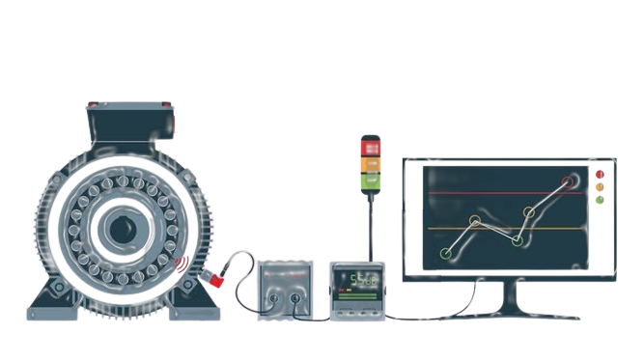

Idea/Approach Details
Flowchart :-
COMMERCIAL BUILDINGS
LARGE SCALE RESIDENTIAL BUILDINGS
SOLAR PANNELS FROM VARIOUS SOLAR FARMS
REMOTE CONDITION MONITORING
GRID
UTILITY POLE
WORK FLOW
WEB APPLICATION
2

Slide 6
SOLUTION ( ITERATION 1 ) :-
Fractionalised investment
Wallet Integration
Smart Contract
ECO
LEDGENCE
Decentralized Ledger
Blockchain Integration
Peer to Peer platform

Slide 7







TOOLS AND TECHNOLOGIES :-
React.js
FRONTEND
.
LIBRAIES ALLOW TO INTERACT WITH LOCAL NODE
Web3.js
Node.js
BACKEND
TO PROGRAM SMART CONTRACT
Solidity
OPEN SOURCE APPLICATION WHICH FACILITIES DEVELOPING, TESTING AND DEPLOYMENT
Remix
.
DIGITAL WALLET
MetaMask
Ethereum
DECENTRALIZED BLOCKCHAIN WITH SMART CONTRACT FUNCTIONALITY
2

Slide 8
FUTURE ITERATIONS
INTAGRATE WITH AI & ML
UPGRADE TO ACCESS OTHER RENEWABLE RESOURCES
UPGRADINGSOLAR INVESTMENT FIRM
CREATE AN OWN BLOCK CHAIN NETWORK

Slide 9
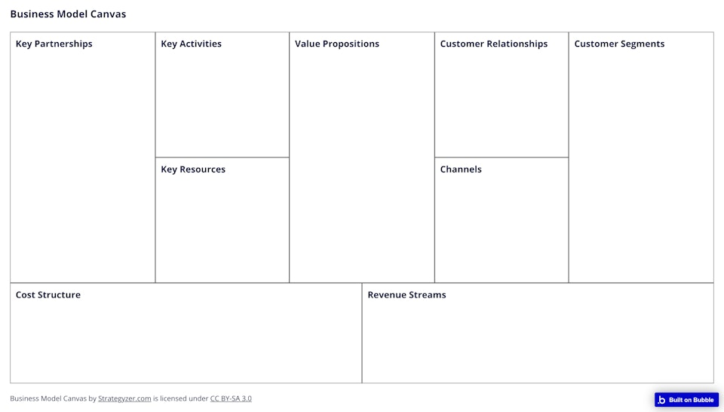
Peer to peer energy trading
New market economy
Decentralized energy market
- Solar panel and battery manufacturer
- Electrical and Electronic manufacturer
-Server maintaining companies
-Government programs and organization.
Ecoledgence is a peer-to-peer energy trading platform built on the blockchain with features like smart contracts, live monitoring, and transparency that enable a decentralized energy market and the emergence of a new market economy
-Real world asset
-Transparency
-Trustworthiness
-Government organisations
-Large Scale Industries
-Commercial building and apartments
-Solar panels
-Electrical and electronical components
-Grid’s
ELECTRICAL
GRIDS
TECHNICAL
-LAPTOP
-MOBILES
-PC
Development cost ₋
This is an new platform in the trading market which is trustable because it is an real world asset .
This platform makes an connection between sellers and buyers to trade their energy in

Slide 10
PROJECT COST OF 1MW SOLAR PLANT
Particulars | Estimated Cost
Solar Panels | 3 Crore
Solar Inverter | 1 Crore
Combiners + Junction Boxes | 20 Lakh
Protective Gears Arrangement | 10 Lakh
SCADA & Data Logger System | 7 Lakh
Land Bank | *5 Acre
Erection of Project | 50 lakh
Total Project Cost | 4.87 Cr. (Approx.)
INCOME
Particulars | Description
Average Daily energy output | 4000 kWh
Annual energy output | 4000×365=14,60,000 units
Govt. pays per unit | 3.85 ₹/unit [According to Central Electricity Regulatory Commission (CERC)]
Total income over the year | ₹56,21,000
Net income over the year | ₹43,51,000 (Total income – Annual Maintenance Cost)

Slide 11
Value Proposition
REDUCTION OF ENERGY WASTE BY 25%
REDUCING THE EMISSION OF CARBON
DECENTRALIZING ENERGY MARKET
COST REDUCTION

Slide 12
Team Member Details
Team Leader Name: KARMUKHILAN D B
Branch: BSc Stream: Digital and cyber forensic science Year: 3rd
Team Member 1 Name: ANASTACIA ALENA ARDELL J G
Branch: BSc Stream: Digital and cyber forensic science Year: 3rd
Team Member 2 Name: MAHALAXMI N
Branch: BSc Stream: Digital and cyber forensic science Year: 3rd
Team Member 3 Name: RAJAPARAMESHWARAN R
Branch: BSc Stream: Digital and cyber forensic science Year: 3rd

